Slide 1
SMART CAMPUS
AI-Driven Campus ERP, Placement Readiness & ATS Resume Analytics Platform
A Comprehensive Machine Learning & Full-Stack System for Higher Education Institutions
ML Placement Engine
Random Forest (76.3% Acc)
NLP ATS Resume Parser
TF-IDF & Cosine Similarity
Academic ERP Hub
Live Timetable & Attendance
Corporate Placement Portal
Job Drives & Application ATS

Slide 2
01. INTRODUCTION
Executive Summary & Core Project Vision
ACADEMIC OPERATIONAL EXCELLENCE
PREDICTIVE CAREER INTELLIGENCE
NLP-DRIVEN EMPLOYABILITY BOOST
1. Integrated Academic ERP
Consolidates daily college administration into a unified portal. Provides a real-time weekly schedule, class status indicators, subject-wise attendance thresholds, course catalogs, and faculty profiles.
2. Machine Learning Placement Engine
Leverages a Random Forest Classifier trained on 15,000 engineering student records. Evaluates 8 key predictive dimensions (DSA, CGPA, Communication, etc.) and provides instant tailored recommendations.
3. Intelligent ATS Resume Analyzer
Parses PDF/DOCX resumes using PyPDF2 & python-docx. Extracts 80+ technical and soft skills, measures cosine similarity against job descriptions, and gives actionable feedback to maximize shortlisting.

Slide 3
02. RESEARCH CONTEXT
Problem Statement & Industry Gaps
❌ Fragmented Campus ERPs
Existing collegiate software tools isolate attendance and marks into static silos. They offer zero correlation between daily student performance and eventual campus recruitment success.
❌ Late Detection of Career Deficiencies
Students typically realize their lack of coding proficiency (DSA), low aptitude scores, or communication deficits during 7th/8th semester drives when remedial action is nearly impossible.
❌ High Rejection Rates at Initial ATS Screening
Over 75% of engineering resumes are screened out before human review due to missing keywords, non-standard formatting, and misalignment with industry job descriptions.
❌ Administrative Placement Overhead
Placement cells spend hundreds of hours manually verifying CGPA eligibility criteria, emailing drive updates, tracking interview pipelines, and managing recruiter logistics.

Slide 4
03. PROJECT SCOPE
Project Objectives & Technical Scope
GOAL 1
Unified Academic Management
Provide seamless student attendance tracking, dynamic weekly scheduling with active-class detection, and academic profile transparency.
GOAL 2
Predictive Placement Analytics
Implement machine learning classification to forecast student placement probability with actionable guidance across 8 critical skill dimensions.
GOAL 3
Intelligent ATS Resume Optimization
Empower students to evaluate resumes against corporate job descriptions using TF-IDF vectorization, cosine similarity, and skill extraction.
GOAL 4
End-to-End Placement Recruitment ATS
Facilitate corporate job listings, automated CGPA eligibility screening, student job applications, and transparent status tracking.
GOAL 5
Data-Driven Placement Cell Dashboard
Provide institutional administrators with high-level KPIs, branch-wise statistics, and tools to manage drives and candidate statuses.

Slide 5
04. ARCHITECTURE
System Architecture & Layered Framework
Layer 1: Presentation & UI
• Responsive HTML5 & Modern Vanilla CSS
• Custom Glassmorphic Dark UI & CSS Grid
• Interactive JavaScript Timetable & Tabs
• Chart.js Interactive Analytics Charts
Layer 2: Application & Controllers
• Python Flask Framework (RESTful Endpoints)
• Session-Based Role Authentication (RBAC)
• Secure File Ingestion (PyPDF2, python-docx)
• Business Logic & Application Status Routing
Layer 3: AI & Machine Learning Core
• Random Forest Classifier (placement_model.pkl)
• Real-time 8-Dimensional Feature Inference
• Scikit-Learn TF-IDF Vectorizer & Cosine Metric
• Heuristic Rule-Based Recommendation Engine
Layer 4: Data & Persistence Layer
• SQLite Relational Database (smart_campus.db)
• 15,000 Records Benchmark Dataset (CSV)
• Entity Tables: students, companies, apps, admins
• Secure Server-side Resumes Directory (/uploads)

Slide 6
05. IMPLEMENTATION
Comprehensive Technology Stack
Backend & Web Framework
• Python 3.10+
Core backend execution language
• Flask Framework
Lightweight, robust WSGI web server
• Werkzeug
Secure file handling and utility helpers
• Jinja2 Engine
Dynamic server-side HTML template rendering
Machine Learning & Data
• Scikit-Learn
RandomForestClassifier, metrics, TF-IDF
• Pandas & NumPy
Dataframe manipulation & matrix math
• Joblib
Fast binary model serialization (.pkl)
• Matplotlib
Analytical charts & visual reporting
NLP & Text Processing
• PyPDF2
Fast programmatic PDF text extraction
• python-docx
Microsoft Word (.docx) document parsing
• Cosine Similarity
Vectorized textual semantic alignment
• RegEx Catalogs
Curated technical & soft skill matchers
Frontend & Persistence
• Vanilla CSS3
Ultra-responsive flexbox & CSS grid
• Modern JavaScript
Asynchronous fetch API & live DOM
• SQLite3 Database
Embedded zero-config relational store
• Font Awesome
Intuitive visual icons & UI cues

Slide 7
06. CORE MODULES
Student ERP & Daily Academic Operations
📅 Dynamic Timetable Engine
Displays weekly schedules from Monday through Friday with exact class time slots, room numbers, lecture types, and assigned professors. Features live class status indicators and RESTful API (/api/timetable/<day>).
📊 Subject-Wise Attendance Tracker
Tracks real-time attendance across 11 accredited engineering subjects. Computes classes attended versus total conducted sessions. Provides visual progress bars and warning indicators when falling below the mandatory 75% cutoff.
👨‍🏫 Faculty Directory & Course Hub
Presents a complete registry of departmental professors, specialized course codes (e.g., BCS501, BCS504, BCS506), syllabus links, and behavioral/open elective details.
👤 Comprehensive Student Profile Ledger
Maintains complete student master data including Enrollment ID, Semester, Program, CGPA, Aptitude/Coding scores, Fee clearance ledger, and state/college tier categorization.

Slide 8
07. AI/ML SYSTEM
Machine Learning Placement Prediction Engine
Random Forest Classification Model
• Ensemble Architecture: 100 decision trees (n_estimators=100) with max_depth=12 to prevent overfitting.
• Input Vector: 8 quantitative parameters encompassing academic, technical, problem-solving, and interpersonal facets.
• Class Probabilities: Generates calibrated percentage probability of placement via predict_proba().
• Explainable AI Advice: Dynamic rule engine evaluates student input against benchmarks to produce targeted improvement recommendations.
• Model Persistence: Serialized into placement_model.pkl for microsecond server-side inference.
The 8 Predictive Feature Dimensions
1. DSA Problems Solved:
Total coding questions completed on LeetCode/GFG
2. CGPA (Cumulative GPA):
Overall academic score index (scale 0 - 10)
3. Communication Score:
Verbal & written score for HR rounds (0 - 100)
4. Attendance Percentage:
Regularity & institutional discipline (0 - 100%)
5. Aptitude Score:
Quantitative, logical, and verbal screening test (0 - 100)
6. Internships Count:
Practical industry internship experience (0 - 4+)
7. Projects Count:
Verified full-stack/AI software capstones (0 - 5+)
8. Certifications Count:
Industry-recognized technical credentials (0 - 6+)

Slide 9
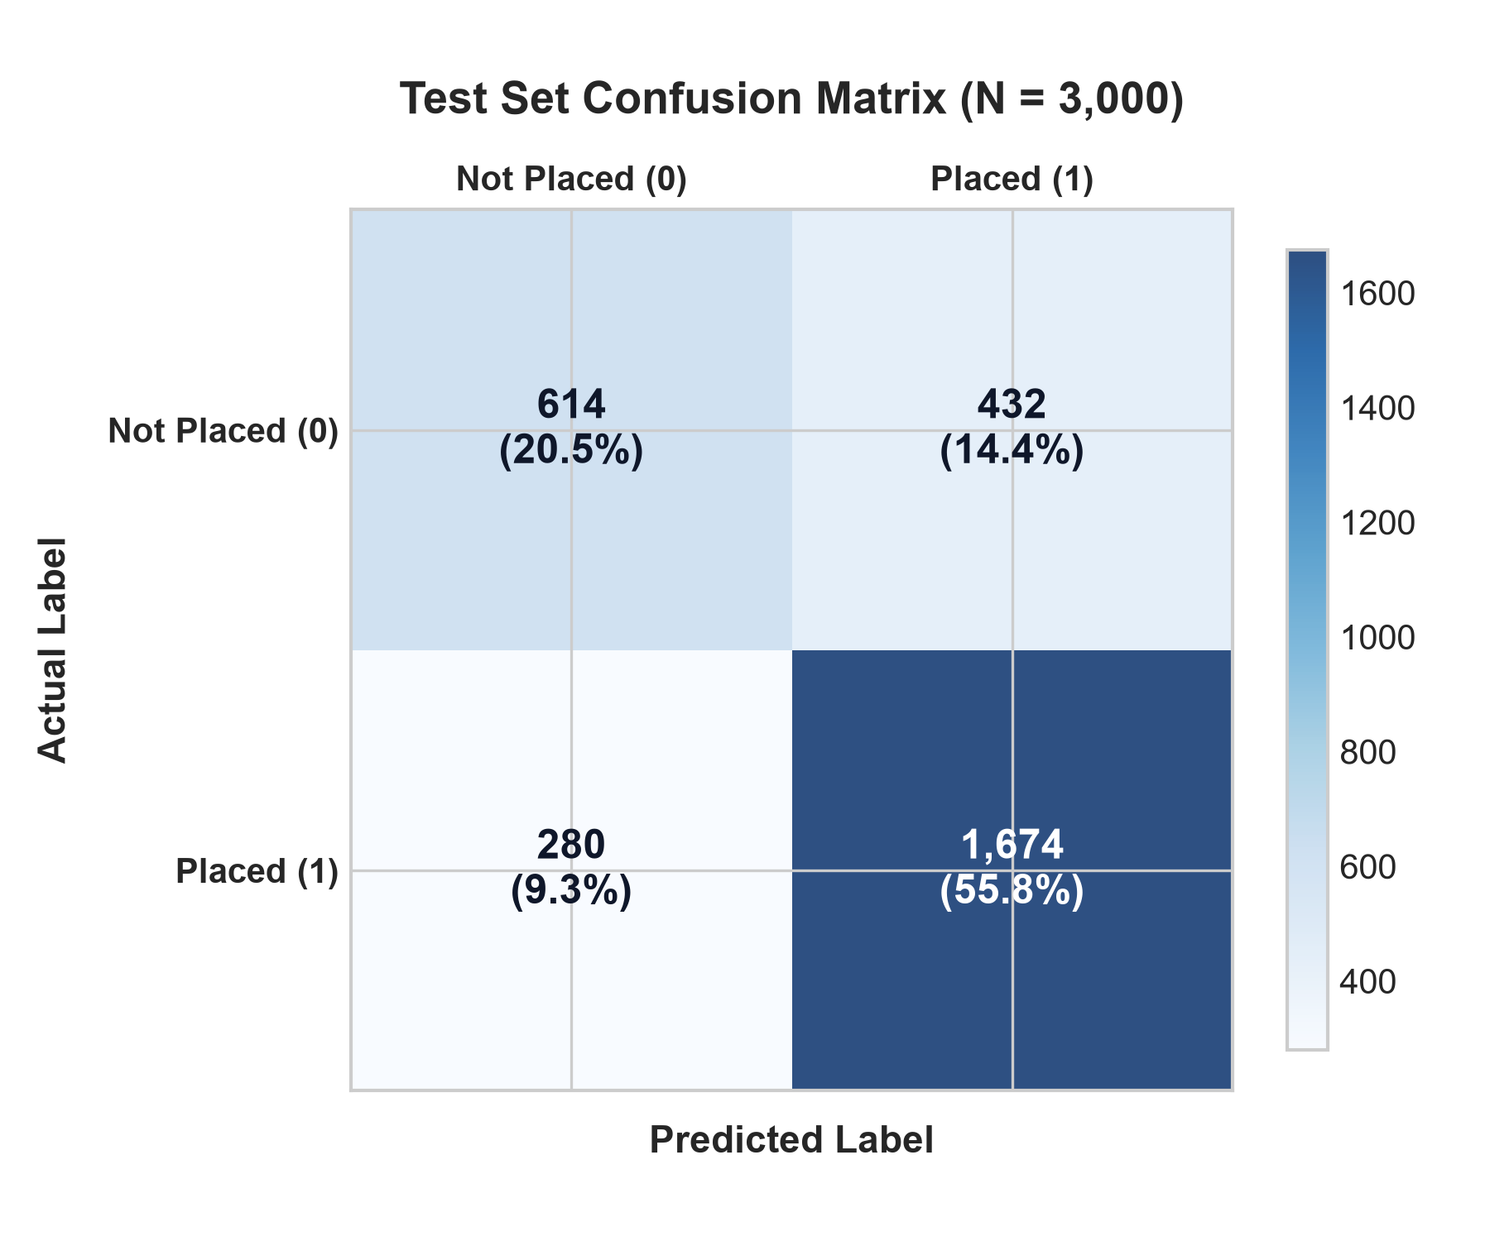
08. EMPIRICAL RESULTS
Dataset Analysis & Training Evaluation
Model Evaluation Breakdown
• Benchmark Dataset:
Indian Engineering Placement Dataset 2026 (15,000 records)
• Data Partitioning:
80% Training (12,000) : 20% Testing (3,000 records)
• Training Accuracy:
89.43% across all classes
• Test Accuracy:
76.27% on unseen student test records
• Placed Class Precision:
79.49% (High confidence on positive predictions)
• Placed Class Recall:
85.67% (Identifies 1,674 of 1,954 placed candidates)
• Placed Class F1-Score:
82.46% (Strong harmonic balance)

Slide 10
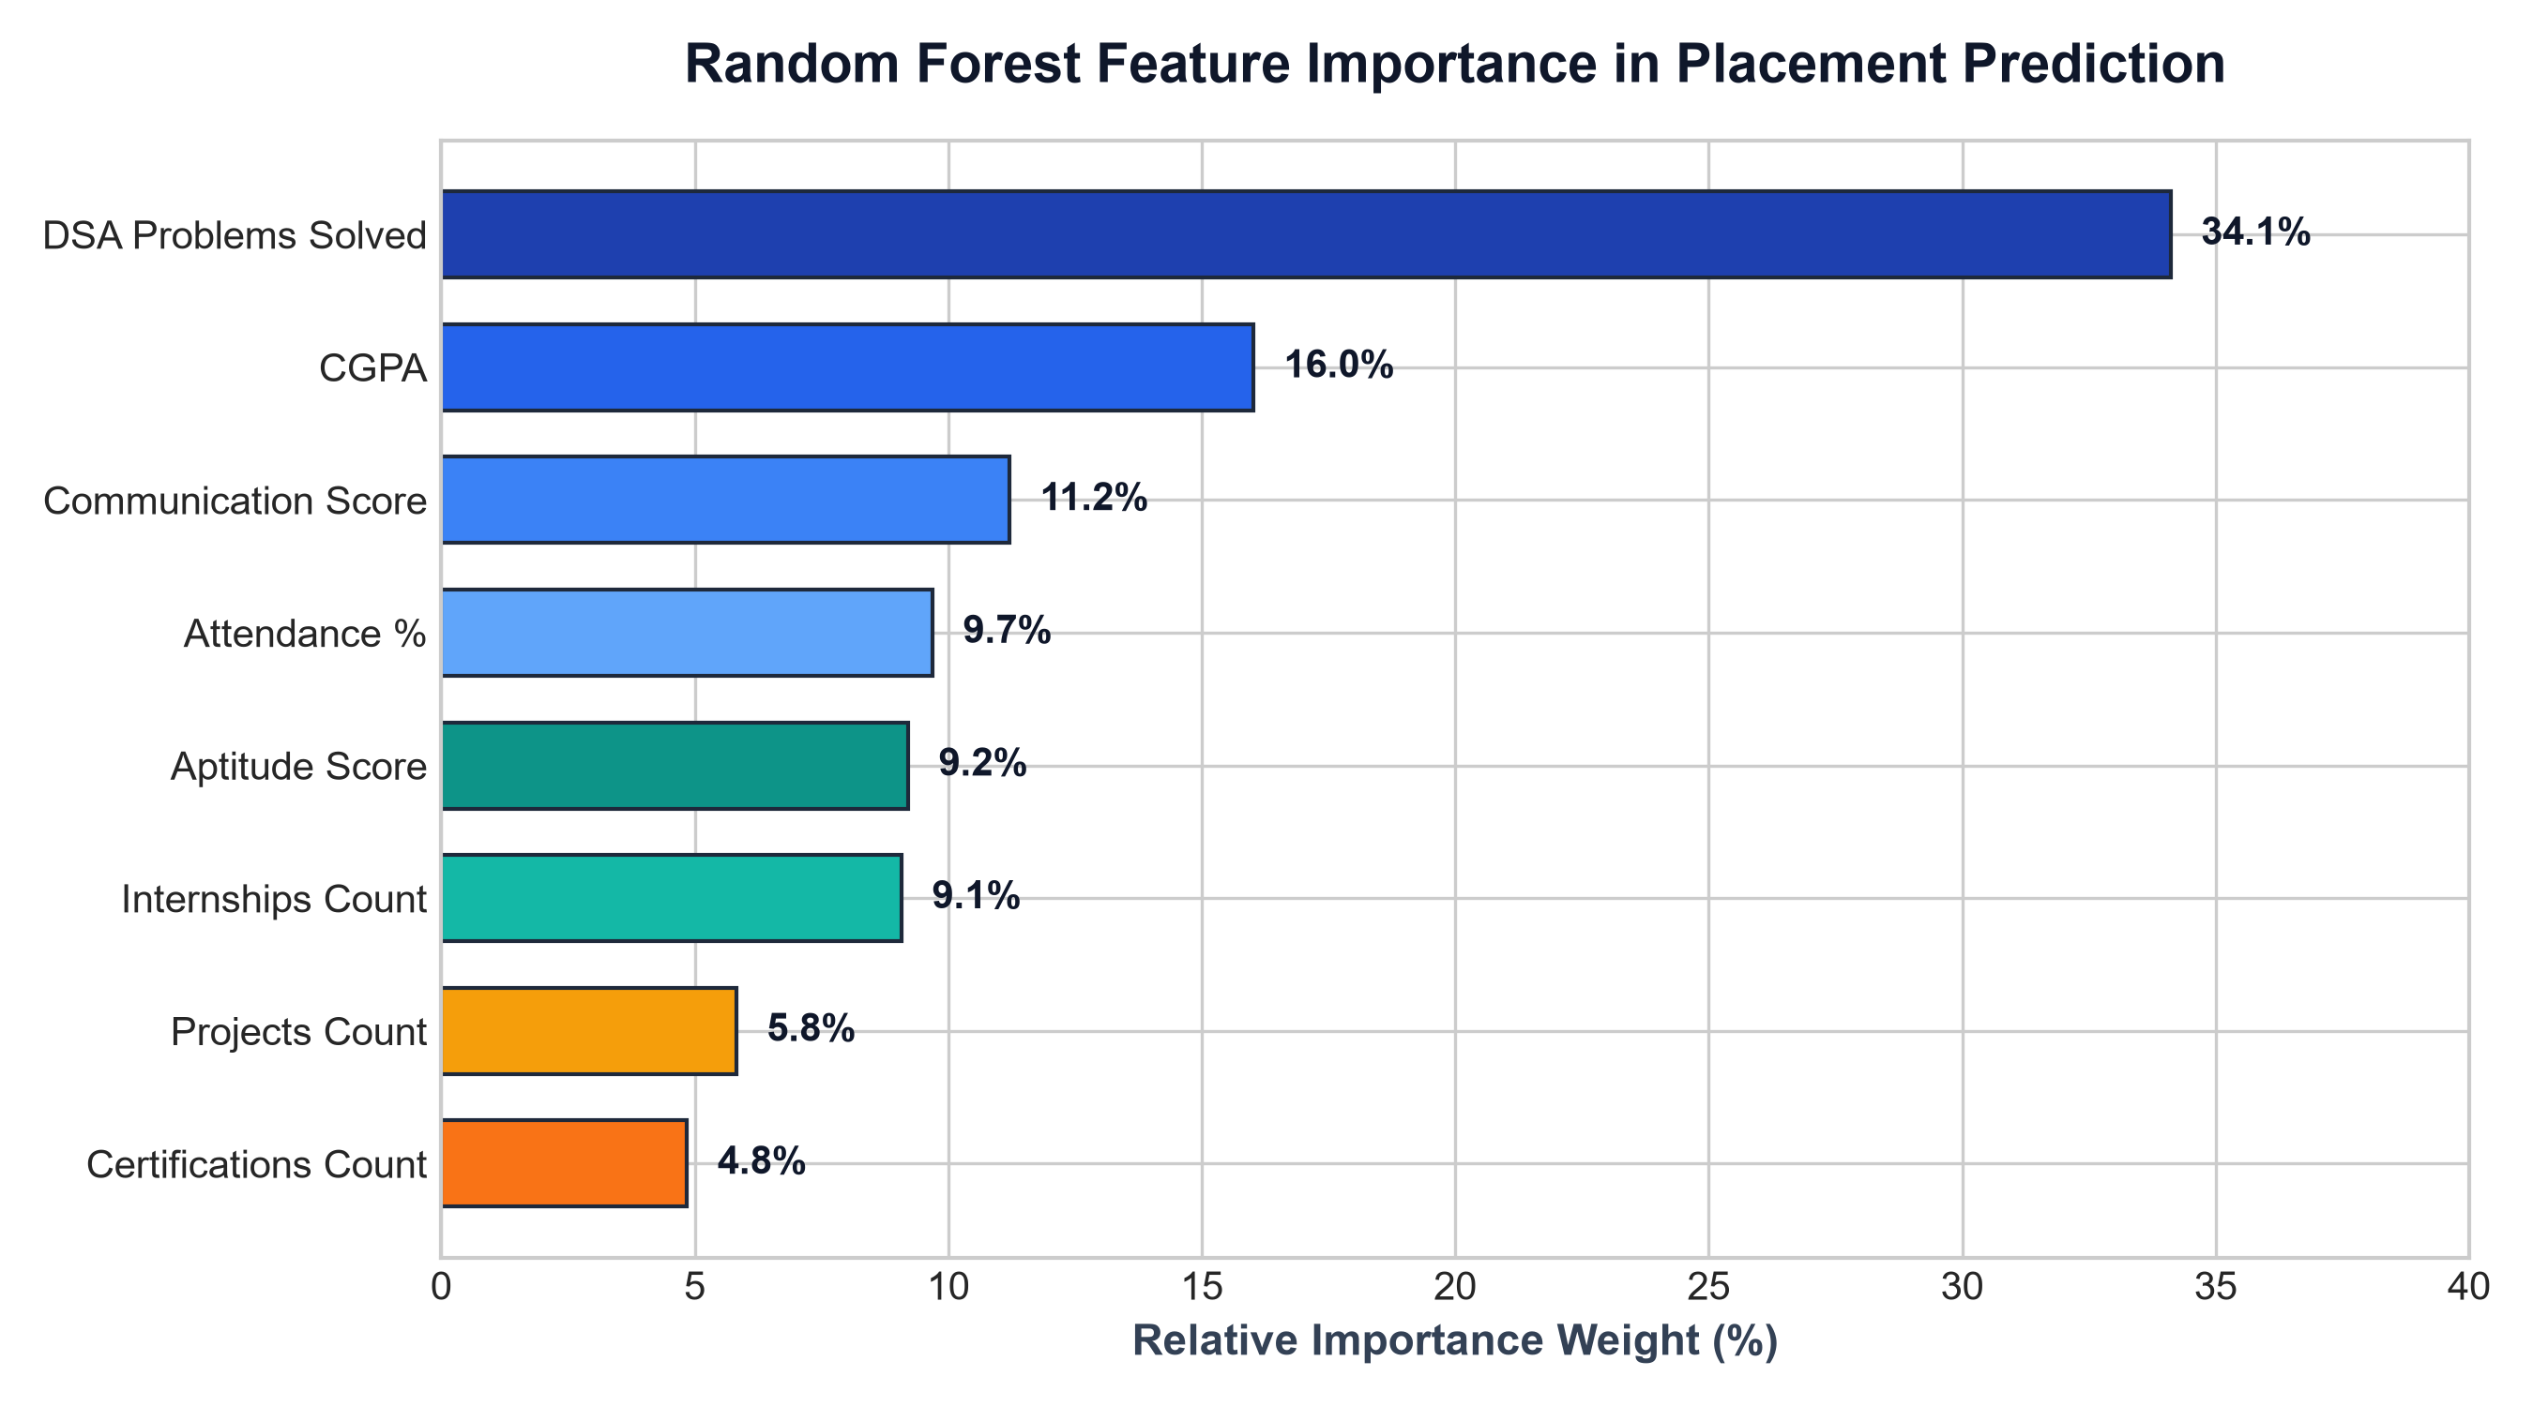
09. ML EXPLAINABILITY
Feature Importance & Key Placement Drivers
Critical Takeaways
1. DSA is King (34.1%): Solving Data Structures & Algorithm problems is by far the single biggest driver of campus placement.
2. CGPA is the Filter (16.0%): Academic grades serve as the primary cutoff threshold for company shortlisting.
3. Soft Skills Matter (11.2%): Strong communication distinguishes technically proficient students in HR interviews.
4. Consistency Counts: Attendance (9.7%) and Aptitude (9.2%) reflect student commitment and cognitive problem solving.

Slide 11
10. NLP SYSTEM
Intelligent ATS Resume Analyzer (NLP Engine)
Multi-Format Document Parser
• Extracts clean text from PDF (PyPDF2) and DOCX (python-docx).
• Sanitizes formatting, normalizes casing, and handles multi-page layouts.
• Auto-associates uploaded files with student session.
Curated Skill Catalog Engine
• Tech Catalog: 64+ languages, frameworks, AI/ML tools, and databases.
• Soft Skills: 16+ behavioral traits (Leadership, Teamwork, etc.).
• Action Verbs: 21+ impactful verbs (Architected, Spearheaded, Optimized).
TF-IDF & Cosine Alignment
• Computes n-gram TF-IDF vector embeddings for resume and job description.
• Calculates mathematical cosine similarity metric (0% to 100%).
• Provides high-precision relevance scores across multiple company profiles.
Automated Gap & ATS Scoring
• Composite ATS Index: Weighted score of Skills (50%), Similarity (30%), Formatting (10%), and Action Verbs (10%).
• Actionable feedback: Lists critical missing keywords needed for recruiter shortlisting.

Slide 12
11. ATS PORTAL
Campus Recruitment & Application Tracking
🏢 Active Corporate Recruitment Drives
Students explore active on-campus hiring drives from leading firms (e.g., TCS, Infosys, Microsoft, Capgemini, Accenture, Cognizant) with detailed role requirements, CTC packages (up to 18 LPA), locations, and deadlines.
🛡️ Automated CGPA Cutoff Validation
System programmatically verifies the candidate's CGPA against the company's minimum threshold (e.g., 8.5 for Microsoft, 7.5 for Infosys). Ineligible applicants are prevented from applying, eliminating screening friction.
⚡ 1-Click Application Pipeline
Eligible students submit applications with a single click. The backend registers the timestamped record in the applications table, preventing duplicate submissions.
📋 Live Status Lifecycle Tracking
Applicants track real-time hiring progress across multiple stages: 'Applied' ➔ 'Shortlisted' ➔ 'Interview' ➔ 'Selected / Placed', accompanied by official coordinator notes.

Slide 13
12. ADMIN PORTAL
Placement Officer (TPO) Command Center
15,000
Total Registered Students
9,780+
Total Placed Candidates
8.45 LPA
Average Placed Package
18.0 LPA
Highest On-Campus Package
Administrative Features
• Dynamic Drive Management: Post new recruitment drives with criteria, package, location, and deadlines.
• Candidate Status Workflow: Seamlessly promote student applications from Applied to Interview or Placed.
• Automated Status Sync: Marking a candidate 'Placed' instantly updates the student master database.
• Multi-Dimensional Filtering: Filter thousands of students by Branch, Placement Status, or search by name.
Departmental Analytics & Reporting
• Branch-Wise Performance: Real-time placement rates across CSE, IT, ECE, Mechanical, and Civil engineering.
• Package Dispersion: Average and median package tracking per academic department.
• Interactive Dataset Explorer: Live search & review of all 15,000 engineering student benchmark records.
• Zero Latency: Optimized SQLite index queries guarantee instantaneous dashboard rendering.

Slide 14
13. DATA PERSISTENCE
Database Architecture & Entity Relationships
TABLE: students
• student_id (PK)
TEXT PRIMARY KEY
• name, password
Authentication & profile
• course, semester
Degree & academic standing
• attendance, cgpa
Academic metrics
• aptitude_score
Quantitative capability
• coding_score
DSA problems solved proxy
• projects, internships
Practical experience counts
• skills, branch, state
Demographics & tech stack
• placement_status
Placed / Not Placed status
• package_lpa
Secured CTC compensation
TABLE: companies
• id (PK)
INTEGER AUTOINCREMENT
• name
Corporate recruiter name
• role
Designation (e.g., SWE)
• package
CTC string (e.g. 9.5 LPA)
• min_cgpa
Eligibility cutoff filter
• required_skills
Target tech requirements
• location, deadline
Drive logistical details
• openings
Number of available seats
TABLE: applications
• id (PK)
INTEGER AUTOINCREMENT
• student_id (FK)
Links to students table
• company_id (FK)
Links to companies table
• status
Applied / Shortlist / Placed
• applied_date
ISO application timestamp
• notes
Recruiter feedback & remarks
• UNIQUE KEY
Prevents duplicate applications
TABLE: admins
• id (PK)
INTEGER AUTOINCREMENT
• username
Admin login handle
• password
Authentication credential
• name
Full administrative name
• role
TPO / Placement Head
• email
Official communication mail

Slide 15
14. VALUE PROPOSITION
Comparative Value & Institutional Impact
🎓 For Students
• Early Predictive Diagnosis: Discover skill deficiencies in 3rd/4th year rather than during final semester drives.
• Personalized Roadmaps: Receive clear, quantitative guidance on CGPA, DSA problem targets, and project requirements.
• ATS Resume Optimization: Maximize resume shortlist rates with instantaneous keyword and cosine semantic matching.
• Frictionless Campus Drives: Apply to multiple hiring opportunities with verified eligibility in a single click.
🏛️ For Placement Cell (TPO)
• 80% Reduction in Administrative Overhead: Automated CGPA validation eliminates manual verification of spreadsheets.
• Real-Time Hiring Pipelines: Instantly monitor student application lifecycles from application to final offer.
• Drive Posting & Communication: Broadcast corporate drives with clear criteria and manage interview slots seamlessly.
• Institutional Placement Analytics: Generate departmental reports and benchmark student readiness.
💼 For Corporate Recruiters
• Pre-Vetted Candidate Funnel: Guaranteed eligibility compliance based on real university grades and metrics.
• Standardized ATS Profiles: Structured resumes parsed with clear skill taxonomies and action verb ratings.
• Accelerated Hiring Turnaround: Conduct campus drives faster with structured student evaluation data.

Slide 16
15. CONCLUSION & ROADMAP
Future Enhancements & Concluding Summary
Future Project Roadmap
• 1. LLM-Powered AI Mock Interviewer: Integrate conversational AI with speech-to-text to simulate HR and technical interviews.
• 2. Automated Offer Letter OCR & Verification: Verify recruiter compensation CTC breakup and authentic employment offers.
• 3. Native Mobile Application: Develop cross-platform Flutter/React Native mobile app with real-time push notifications.
• 4. WhatsApp / SMS Notification Gateway: Instant interview alerts and reminder triggers for scheduled drive rounds.
• 5. Deep Learning Recommendation Engine: Personalized course & LeetCode problem recommendations based on target company.
Concluding Takeaway
Smart Campus bridges the critical divide between collegiate academic management and student career readiness. By combining high-accuracy Machine Learning (Random Forest 76.3%), NLP Resume Intelligence (TF-IDF & Cosine Similarity), and an end-to-end recruitment tracking portal, the platform transforms static universities into intelligent career hubs.
Thank You!
Questions & Discussion

